Slide 1
Chapter 6
Page Layout
with Floats

Slide 2
Objectives
Applied
Given an HTML document, create a CSS style sheet that uses floating to implement a fixed or fluid page layout in two- or three-column format with both header and footer.
Knowledge
Describe the use of floating for page layout.
Describe the use of the clear property in a CSS rule set.
Distinguish between fixed and fluid page layout.
Describe the use of the CSS3 feature for text columns.
Describe the use of absolute, relative, and fixed positioning.

Slide 3
Old Practices
Most of the tools for page layout in this chapter are old.
The examples do not demonstrate modern practices for responsive design.
When the this textbook was initially published:
Websites where largely viewed on 4:3 monitors.
Minimum target resolution was 800x600
Maximum target resolution was 1680x1050
The most popular resolution was 1280x1024

Slide 4
Current Practices
Websites today:
Must be able to handle a broad range of form factors.
Must support smartphones, tablets, monitors, and laptops of all sizes.
Most devices have a 19:10 aspect ratio, in landscape orientation.
Cell phones range in resultion from 320x568 to 1080x1920.
Laptops and monitors range in resultion from 1280x1024 to 3840x2160.
The most popular laptop/monitor resolution is 1920x1080.
As such, the tools presented in this chapter are not recommended for creating modern responsive websites.
We will discuss CSS FlexBox in a later chapter.

Slide 5
Page Layout Practices Over Time
Tables
Floats
FlexBox

Slide 6

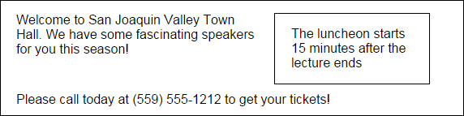
The web page with the side bar in a browser
Without CSS
With CSS
book_examples/ch06/01_float_clear.html

Slide 7
The HTML for a web page with a sidebar
<body>
<aside>
<p>The luncheon starts 15 minutes after the lecture ends</p>
</aside>
<main>
<p>Welcome to San Joaquin Valley Town Hall. We have some fascinating speakers for you this season!</p>
</main>
<footer>
<p>Please call today at (559) 555-1212 to get your tickets!</p>
</footer>
</body>
book_examples/ch06/01_float_clear.html

Slide 8
The CSS for floating the sidebar
body {
width: 500px;
}
main, aside, footer {
margin: 0;
padding: 0px 20px;
}
p {
margin: 1em 0;
}
aside {
margin: 0 20px 10px;
width: 150px;
float: right;
border: 1px solid black;
}
footer {
clear: both;
}
book_examples/ch06/01_float_clear.html

Slide 9
The HTML for the 2-column layout
<body>
<header>
<h2>Header</h2>
</header>
<main>
<h2>Main content</h2>
</main>
<aside>
<h2>Aside</h2>
</aside>
<footer>
<h2>Footer</h2>
</footer>
</body>
book_examples/ch06/02_2_column_fixed.html

Slide 10
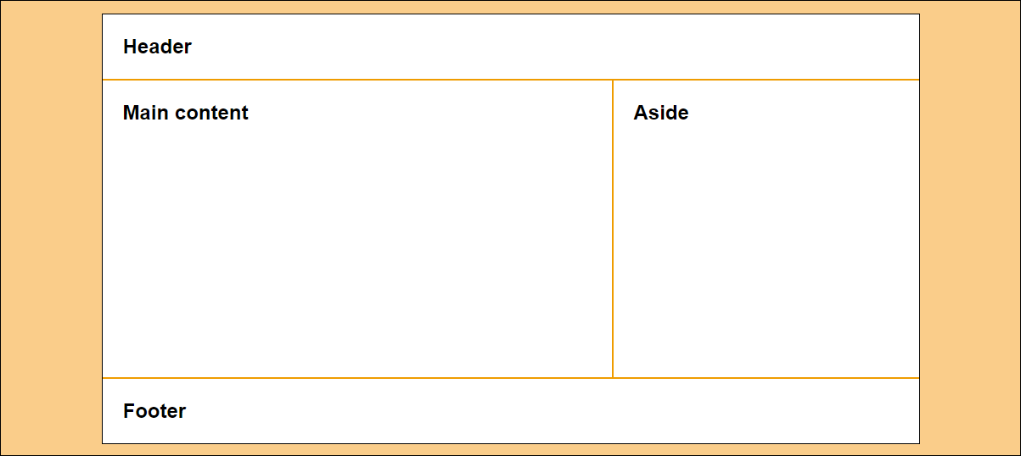
A 2-column web page with fixed-width columns
main {width: 600px}
aside
{width: 360px}
body {width: 962px}
book_examples/ch06/02_2_column_fixed.html

Slide 11
The CSS for the 2-column, fixed-width page
body {
width: 962px;
margin: 15px auto;
}
main {
width: 600px;
float: left;
}
aside {
width: 360px;
float: right;
}
footer {
clear: both;
}
book_examples/ch06/02_2_column_fixed.html

Slide 12
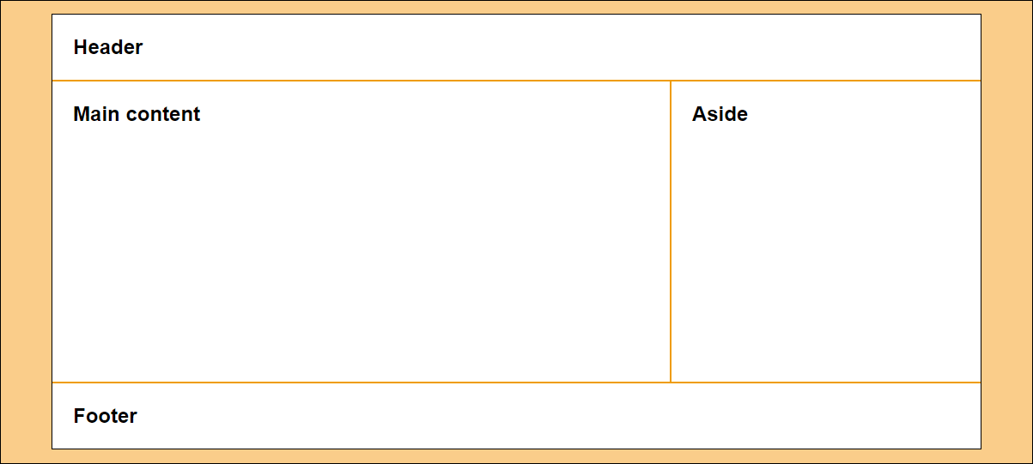
A 2-column page with fluid column widths
main {width: 66%}
aside
{width: 33%}
body {width: 90%}
book_examples/ch06/03_2_column_liquid.html

Slide 13
The CSS for the 2-column, fluid page
body {
width: 90%;
margin: 15px auto;
}
main {
width: 66%;
float: left;
}
aside {
width: 33%;
float: right;
}
footer {
clear: both;
}
book_examples/ch06/03_2_column_liquid.html

Slide 14
A 2-column page with fixed aside and fluid main
main {width: calc(90% - 360px)}
aside
{width: 360px}
body {width: 90%}
book_examples/ch06/03_2_column_liquid.html

Slide 15
The CSS when the aside is fixed and the main content is fluid
body {
width: 90%;
margin: 15px auto;
}
main {
width: calc(90% - 360px);
float: left;
}
aside {
width: 360px;
float: right;
}
footer {
clear: both;
}
book_examples/ch06/03_2_column_liquid_fixed.html

Slide 16
The HTML for the 3-column page
<body>
<header>
<h2>Header</h2>
</header>
<aside id="sidebarA">
<h2>Sidebar A</h2>
</aside>
<main>
<h2>Main content</h2>
</main>
<aside id="sidebarB">
<h2>Sidebar B</h2>
</aside>
<footer>
<h2>Footer</h2>
</footer>
</body>
book_examples/ch06/04_3_column_fixed.html

Slide 17
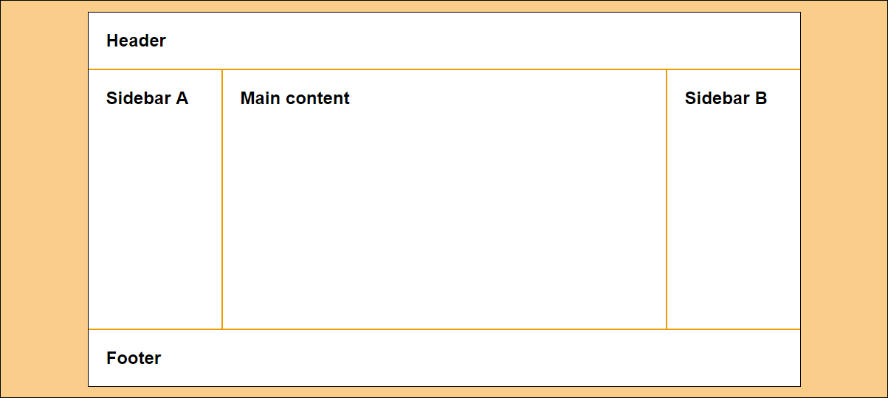
A 3-column page with fixed-width columns
180px
600px
180px
body {width: 964px}
book_examples/ch06/04_3_column_fixed.html

Slide 18
The CSS for the 3-column, fixed-width page
body {
width: 964px;
}
#sidebarA {
width: 180px;
float: left;
}
main {
width: 600px;
float: left;
}
#sidebarB {
width: 180px;
float: right;
}
book_examples/ch06/04_3_column_fixed.html

Slide 19
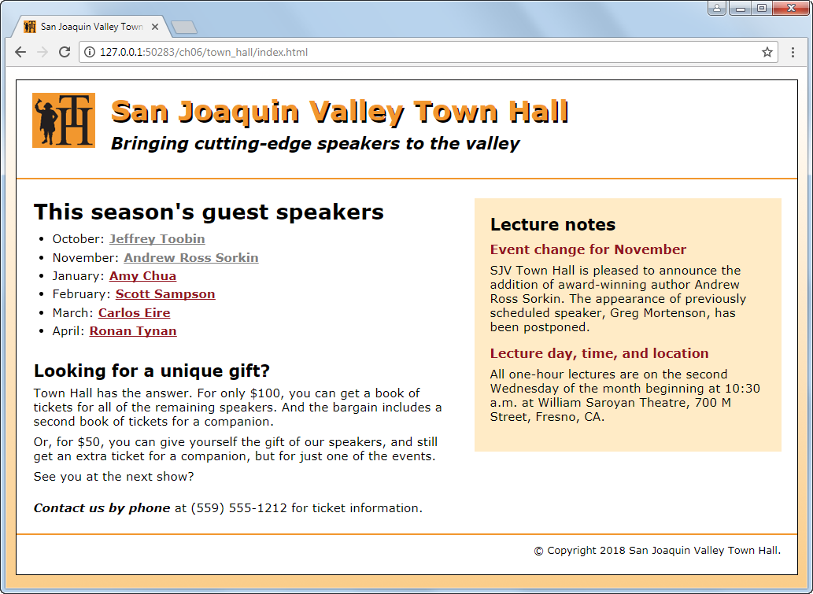
A home page with a sidebar floated to the right
book_apps/ch06/town_hall

Slide 20
The HTML for the home page (part 1)
<head>
...
<link rel="stylesheet" href="styles/normalize.css">
<link rel="stylesheet" href="styles/main.css">
</head>
<body>
<header>
<img src="images/logo.jpg" alt="Town Hall Logo" width="80">
<h2>San Joaquin Valley Town Hall</h2>
<h3>Bringing cutting-edge speakers to the valley</h3>
</header>
<main>
<aside>...</aside>
<section>...</section>
</main>
book_apps/ch06/town_hall

Slide 21
The HTML for the home page (part 2)
<footer>
<p>&copy; Copyright 2018 San Joaquin Valley Town Hall.</p>
</footer>
</body>
</html>
book_apps/ch06/town_hall

Slide 22
The CSS for the home page
body {
width: 992px;
margin: 1em auto;
padding: 1em 0;
}
section {
width: 535px;
float: right;
}
aside {
width: 350px;
float: right;
}
footer {
clear: both;
}
book_apps/ch06/town_hall

Slide 23
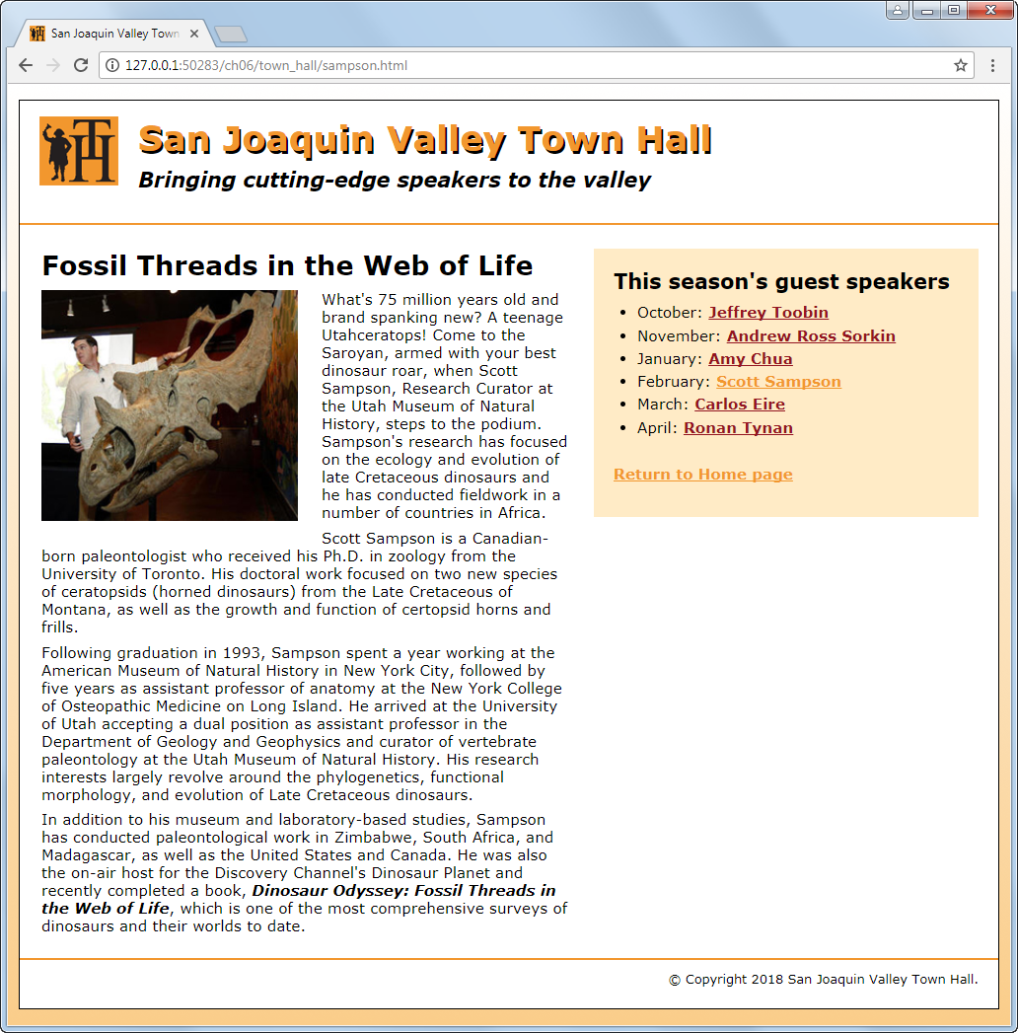
A speaker page with a sidebar on the right
book_apps/ch06/town_hall

Slide 24
The HTML for the speaker page
<head>
...
<link rel="stylesheet" href="styles/normalize.css">
<link rel="stylesheet" href="styles/speaker.css">
</head>
<body>
<header>...</header>
<main>
<aside>...</aside>
<article>...</article>
</main>
</body>
book_apps/ch06/town_hall

Slide 25
The CSS for the speaker page
body {
width: 992px;
margin: 1em auto;
padding: 1em 0;
}
article {
width: 535px;
float: right;
}
aside {
width: 350px;
float: right;
}
footer {
clear: both;
}
book_apps/ch06/town_hall

Slide 26
The primary CSS3 properties for creating text columns
column-count
column-gap
column-rule
3 columns with default-sized gaps
article { column-count: 3; }
3 columns with 35px gaps and 2px rules between the columns
article {
column-count: 3;
column-column-gap: 35px;
column-rule: 2px solid black;
}
book_examples/ch06/10_text_columns.html

Slide 27

3 columns with 35px gaps and 2px rules in a browser window
Try it out
http://aaronlumsden.com/multicol/
https://web.archive.org/web/20180312212924/https://aaronlumsden.com/multicol/
book_examples/ch06/10_text_columns.html

Slide 28
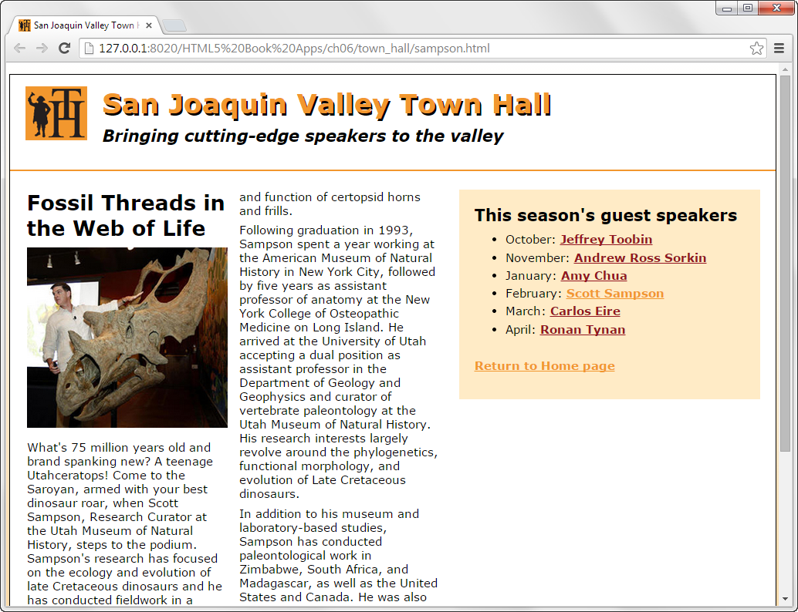
A web page with a two-column article
article { column-count: 2; }

Slide 29
Properties for positioning elements
position
top, bottom, left, right
z-index
Possible values for the position property
static
absolute
fixed
relative
sticky
More Information
https://www.w3schools.com/css/css_positioning.asp
book_examples/ch06/13_absolute_and_fixed.html

Slide 30
The HTML for a web page that will use positioning
<body>
<main>
<h1>Our speakers this season</h1>
<ul>
<li>October: <a href="speakers/toobin.html">
Jeffrey Toobin</a></li>
<li>November: <a href="speakers/sorkin.html">
Andrew Ross Sorkin</a></li>
<li>January: <a href="speakers/chua.html">
Amy Chua</a></li>
</ul>
<p>Please contact us for tickets.</p>
</main>
<aside>
<p><a href="raffle.html">Enter to win a free ticket!</a></p>
</aside>
</body>
book_examples/ch06/13_absolute_and_fixed.html

Slide 31
The CSS for the web page with absolute positioning
body {
/* not needed for fixed positioning */
position: relative;
width: 550px;
border: 1px solid black;
}
aside {
/* change to fixed for fixed positioning */
position: absolute;
right: 30px;
top: 50px;
width: 80px;
}
book_examples/ch06/13_absolute_and_fixed.html

Slide 32
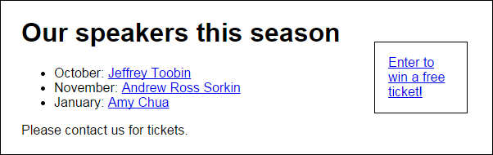
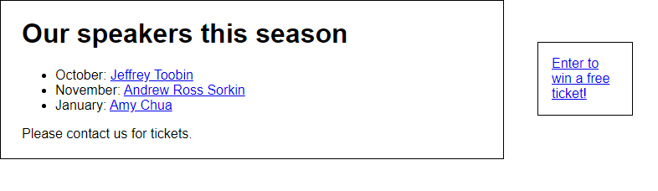
The web page in a browser
Absolute Positioning
Fixed Positioning
book_examples/ch06/13_absolute_and_fixed.html

Slide 33
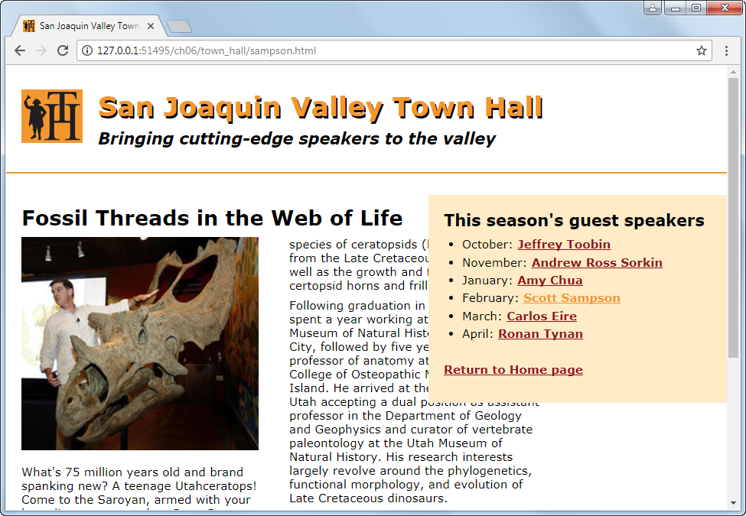
A sidebar that uses fixed positioning
aside {
position: fixed;
right: 0;
top: 170px;
width: 350px;
}

Slide 34

Short 6-1 Use the CSS3 columns feature

Slide 35

Short 6-2 Switch the columns of a page

Slide 36
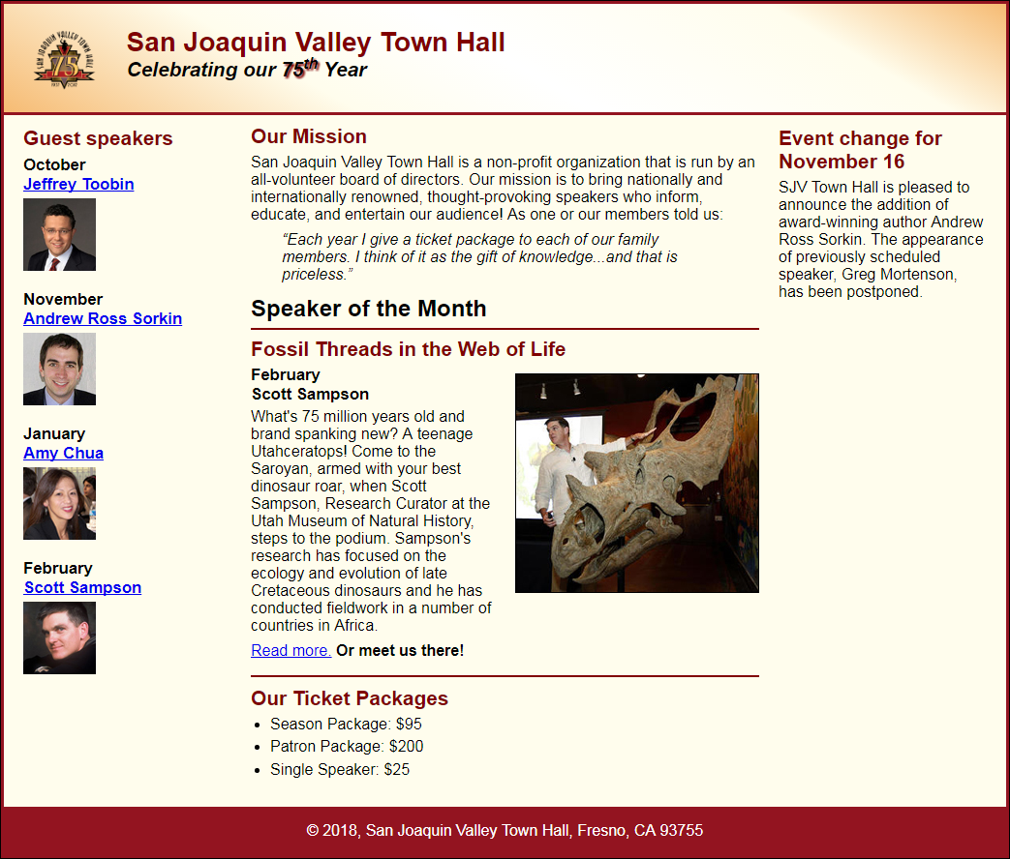
Short 6-3 Add a third column to a page

Slide 37
Objectives
Applied
Given an HTML document, create a CSS style sheet that uses floating to implement a fixed or fluid page layout in two- or three-column format with both header and footer.
Knowledge
Describe the use of floating for page layout.
Describe the use of the clear property in a CSS rule set.
Distinguish between fixed and fluid page layout.
Describe the use of the CSS3 feature for text columns.
Describe the use of absolute, relative, and fixed positioning.

Slide 38
Assignments
Reading assignments on Perusall
Homework and Labs on InsideRanken

